Slide 1
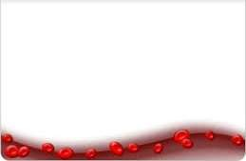
Heme synthesis and porphyrias

Slide 2






Heme is present in:
Hemoglobin.
Myoglobin.
Cytochromes.
Peroxidase.
Catalase.
Tryptophan pyrrolase.
Nitric oxide synthase.

Slide 3



Hemoglobin contain four Heme groups.
Each Heme holds one iron atom, each iron atom holds one
molecule of oxygen.
Four oxygen molecules.
. 250 million molecules of hemoglobin per cell.
Each red blood cell carries one billion molecules of oxygen.

Slide 4

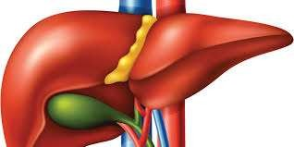
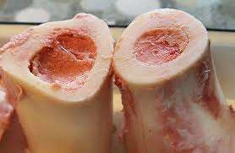








Organs mainly involved in Heme synthesis ?
variable
constant

Slide 5

Which part of the cell does the Heme synthesis take place?

Slide 6
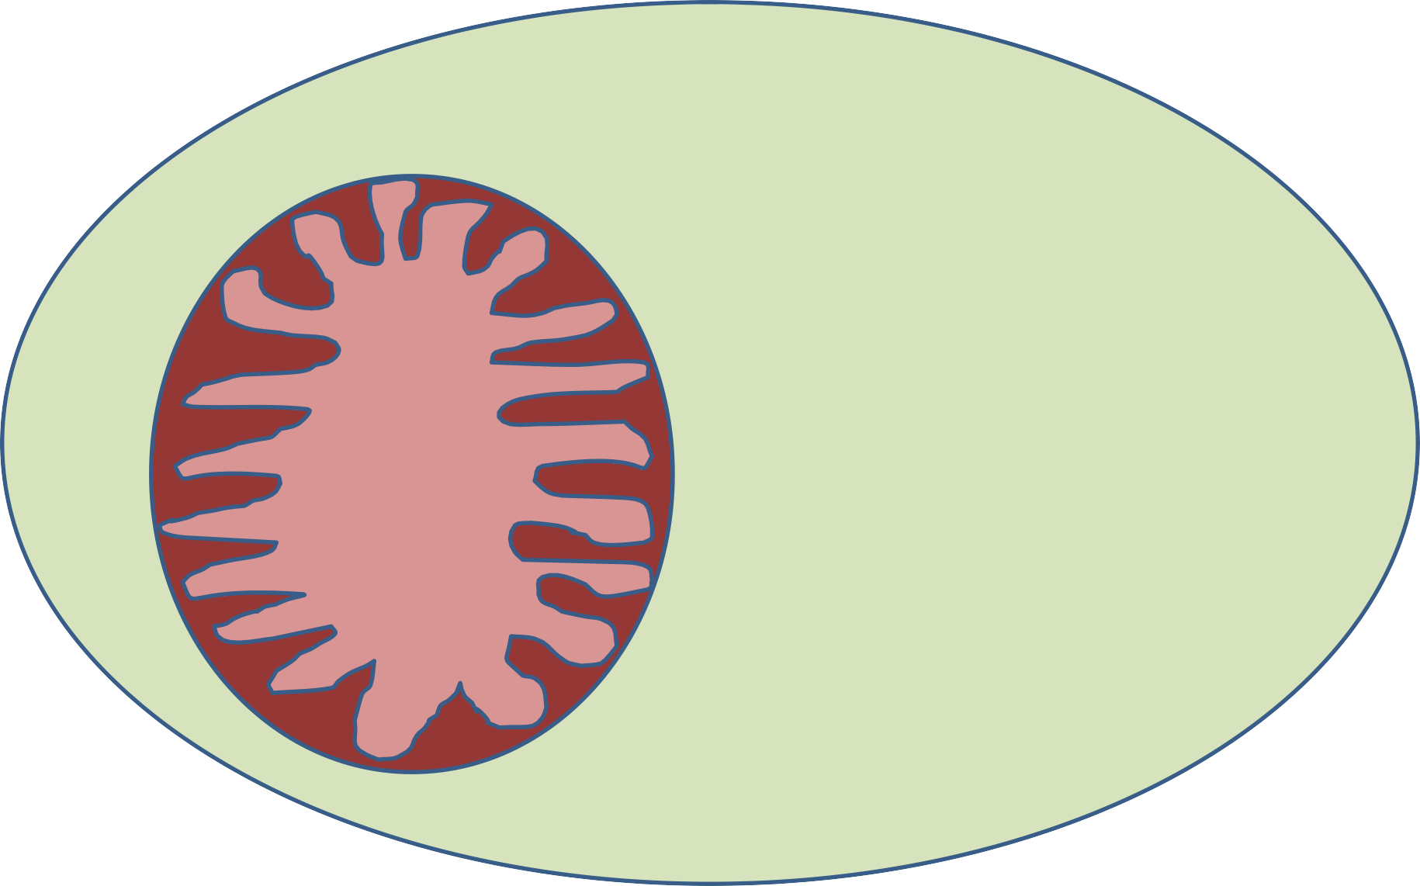
cytosol
mitochondria

Slide 7










Heme
Heme degradation
Heme synthesis
Bile pigments + iron

Slide 8




How is the structure of porphyrin ?
Porphyrins are cyclic compounds formed by the linkage of four pyrrole rings through methyne (=HC —) bridges
A characteristic property of porphyrins is the formation of complexes with metal ions bound to the nitrogen atom of the pyrrole rings

Slide 9



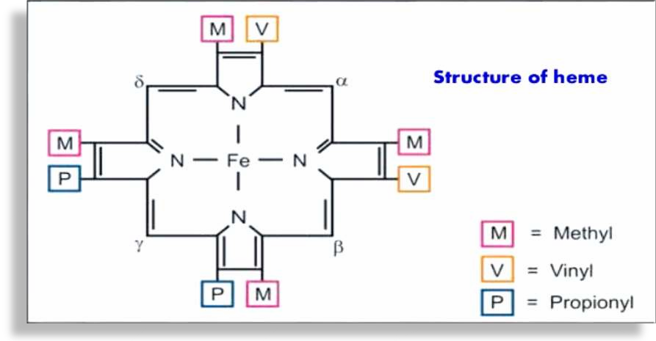
Structure of Heme

Slide 10

He m e synthesis

Slide 11
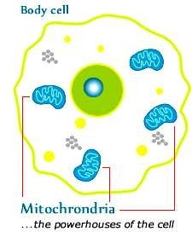

Slide 12















Step-1 (mitochondria(
From citric acid cycle Non essential amino acid
Succinyl-CoA
Glycine
( Pyridoxal phosphate activates )
condensation reaction
ALA
synthase
CoA-SH
α-amino-β-ketoadipic acid

Slide 13








Step-2 (mitochondria)
α-amino-β-ketoadipic acid
decarboxylation reaction
ALA synthase
(rate controlling enzyme - porphyrin biosynthesis – liver)
δ-aminolevulinate (ALA)

Slide 14









Step-3 (cytosol(
( 2molecules )
δ-aminolevulinate (ALA)
ALA dehydratase
2H₂0
zinc-containing enzyme and is
sensitive to inhibition by lead.
(1) porphobilinogen (PBG(
First precursor of pyrrole

Slide 15








Step-4 (cytosol(
(4molecules)
porphobilinogen (PBG)
AIP
condenses
uroporphyrinogen I
synthase
4NH₃
Hydroxy methyl bilane HMB linear tetra pyrrole
PBG deaminase HMB synthase

Slide 16










Step-5 (cytosol (
Hydroxymethylbilane (HMB(
uroporphyrinogen III
synthase
Uroporphyrinogen I
HMB cyclizes spontaneously
Uroporphyrinogen III
CEP
Forms under normal conditions

Slide 17




















Step-6 (mitochondria(
uroporphyrinogen I
uroporphyrinogen III
6H
light
6H
Uroporphyrinogen decarboxylase
light
Uroporphyrin I
Uroporphyrin III
coproporphyrinogen I
coproporphyrinogen III
6H
6H
light
light
PCT
Coproporphyrin I
Coproporphyrin III

Slide 18




Step-7 (mitochondria(
coproporphyrinogen III
Coproporphyrinogen oxidase
HCP
Protoporphyrinogen III

Slide 19



Step-8 (mitochondria(
Protoporphyrinogen III
Protoporphyrinogen oxidase
Por.variegata
Protoporphyrin III

Slide 20





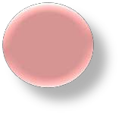


Step-9 (mitochondria (
Protoporphyrin IX
Heme synthase
Ferrochetalase
H.protoporphyria
Heme

Slide 21
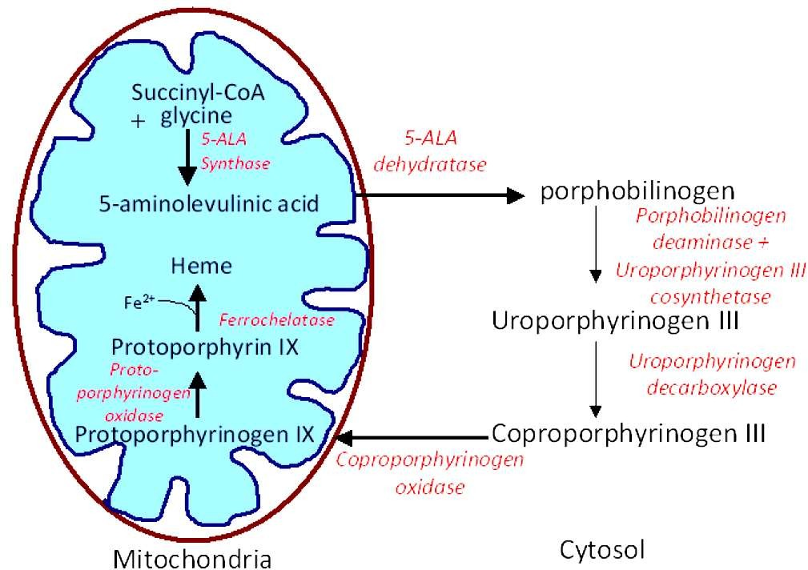

Slide 22







Regulation of Heme Synthesis
Heme inhibits the synthesis of ALA synthase
repression mechanism
ALA synthase is also allosterically inhibited by
hematin.
The compartmentalization of the enzymes, makes the regulation easier.
The steps catalyzed by ferrochelatase and ALA dehydratase are inhibited by lead.

Slide 23




Regulation of Heme Synthesis
Drugs like barbiturates induce heme synthesis. Barbiturates require the heme containing cytochrome P450 for their metabolism.
Out of the total heme synthesized, two thirds are used for cytochrome P450 production.
INH (Isonicotinic acid hydrazide) that decreases the availability of pyridoxal phosphate may also affect heme synthesis.

Slide 24
Regulation of Heme Synthesis
High cellular concentration of glucose prevents induction of ALA synthase.
This is the basis of administration of glucose to relieve the acute attack of porphyrias.
Regulation in the erythroid cells :
The enzyme ALA synthase does not appear to control the heme synthesis in the erythroid cells.
Uroporphyrinogen synthase and ferrochelatse mostly regulate heme formation in these cells.

Slide 25




What are porphyrias ?
Porphyria refers to a growing collection of disorders in which there are abnormalities in the enzymes involved in Heme synthesis.
Although porphyrias are not very prevalent,
physicians must be aware of them.

Slide 26





What are the causes of porphyrias?
There are at least eight steps in the production of Heme, and at least eight different types of porphyria can result when an enzyme malfunctions and levels of intermediate substances rise to beyond what the body is needed.

Slide 27

Porphyrias classification
This classification is based on the major site, where the enzyme deficiency is manifested.
The porphyrias are classified as erythropoietic or hepatic, depending on whether the enzyme deficiency occurs in the erythropoietic cells of the bone marrow or in the liver.
Hepatic porphyrias can be further classified as chronic or acute.

Slide 28


Porphyrias classification
In general, individuals with an enzyme defect prior to the synthesis of the tetrapyrroles manifest abdominal and neuropsychiatric signs.
Whereas those with enzyme defects leading to the accumulation of tetrapyrrole intermediates show photosensitivity.
That is, their skin itches and burns when exposed to visible light.

Slide 29






Acute intermittent porphyria
4 molecules
porphobilinogen ( PBG(
This disorder occurs due to the deficiency of the enzyme uroporphyrinogen I synthase.
Characterized by increased excretion of
porphobilinogen and 6-aminolevulinate.
The urine gets darkened on exposure to air due to the conversion of porphobilinogen to porphobilin and porphyria.
condenses
Uroporphyrinogen
I synthase
Hydroxymethylbilane HMB(linear tetrapyrrole)

Slide 30

Other characteristic features of AIP
Usually expressed after puberty in humans.
The symptoms include abdominal pain, vomiting and cardiovascular abnormalities.
The neuropsychiatric disturbances observed.
The symptoms are more severe after administration of
Drugs: e.g. Barbiturates.
These patients are not photosensitive since the enzyme defect occurs prior to the formation of uroporphyrinogen.

Slide 31







Congenital erythropoietic porphyria
characteristic features
Rare congenital disorder
Autosomal recessive
Confined to erythropoietic tissues.
The individuals excrete uroporphyrinogen I and coproporphyrinogen I which oxidize respectively to uroporphyrin I and coproporphyrin |. red pigments.
Hydroxymethylbilane
uroporphyrinogen III synthase
uroporphyrinogen III
The patients are photosensitive.
Increased hemolysis.

Slide 32


Porphyria cutanea tarda
uroporphyrinogen I
uroporphyrinogen III
Uroporphyrinogen decarboxylase
coproporphyrinogen I coproporphyrinogen III
This is also known as cutaneous hepatic porphyria.
The most common porphyria .
Usually associated with liver damage caused by alcohol
overconsumption or iron overload.
The partial deficiency of the enzyme uroporphyrinogen
decarboxylase appears to be responsible for the occurrence
of porphyria cutanea tarda.

Slide 33
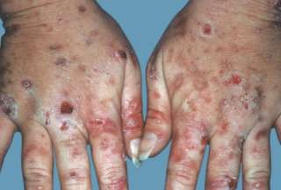
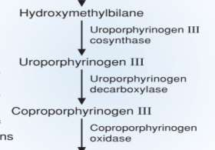


Slide 34

Porphyria cutanea tarda
The other characteristic features include:
Increased excretion of uroporphyrins l and lll and rarely porphobilinogen.
Cutaneous photosensitivity is the most important clinical manifestation of these Patients.
Liver exhibits fluorescence due to high concentration of accumulated porphyrins.

Slide 35






Hereditary cutaenia tarda
coproporphyrinogen III
Coproporphyrinogen
oxidase
Protoporphyrinogen III
Coproporphyrinogen lll and other intermediates (ALA and PBC)
excreted in urine and feces.
The patients of hereditary coproporphyria are photosensitive.
They exhibit the clinical manifestations observed in the
patients of acute intermittent porphyria.
Infusion of hematin is used to control this disorder.
Hematin inhibits ALA synthase and thus reduces the
accumulation of various intermediates.

Slide 36

Variegate porphyria
Protoporphyrinogen III
Protoporphyrinogen
oxidase
Protoporphyrin IX
The enzyme protoporphyrinogen oxidase is defective in this
disorder.
Due to this blockade, protoporphyrin lX required for the ultimate
synthesis of Heme is not produced.
Almost all the intermediates (porphobilinogen, coproporphyrin,
uroporphyrin, protoporphyrin etc.) of Heme synthesis accumulate
in the body and are excreted in urine and feces.
The urine of these patients is coloured and they exhibit
photosensitivity.

Slide 37

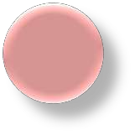
Protoporphyria
Protoporphyrin IX
Heme synthase
Ferrochetalase
Heme
This disorder, also known as erythropoietic protoporphyria
Deficiency of the enzyme ferrochelatase.
Protoporphyrin lX accumulates in the tissues and is
excreted into urine and feces.
Reticulocytes (young RBC) and skin biopsy exhibit red
fluorescence.

Slide 38





Acquired porphyrias (toxic(
The porphyrias, though not inherited, may be acquired due to the toxicity of several compounds.
Exposure of the body to :
Heavy metals e.g. lead,
Toxic compounds e.g hexachlorobenzene.
Drugs.
E.g. Griseofulvin inhibits many enzymes in heme
synthesis.
These include:
ALA dehydratase.
Uroporphyrin I synthase.
Ferrochetalase.

Slide 39

Diagnosis
The best time to attempt diagnosis is when the symptoms are active.
Porphyria sufferers are affected by anything that can alter the functioning of the deficient enzymes.
Disease can occur to different degrees.
Some people are affected so slightly that the diagnosis is never considered.
Herbs, drugs, alcohol and even hormones can produce acute attacks by interfering with enzyme function.

Slide 40
Diagnosis
Lab tests are required to make a definitive diagnosis of porphyria and to determine which form of the disease you have.
If your doctor suspects porphyria, he or she may recommend these tests:
Urine , blood and stool: Examination for various porphyrins.
Spectrophotometry: Is Used to Test for Porphyrins & Their Precursors Coproporphyrins and uroporphyrins.

Slide 41
Urine test:
If you have a form of acute porphyria, a urine test may reveal elevated levels of two substances:
porphobilinogen and delta- aminolevulinic acids,
as well as other porphyrins.
Blood test:
If you have a form of cutaneous porphyria, a blood test may show an elevation in the level of porphyrins in your blood plasma.
Stool sample test:
Analysis of a stool sample may reveal elevated levels of some porphyrins that may not be detected in urine samples.
This test may help your doctor determine your specific type of porphyria.

Slide 42
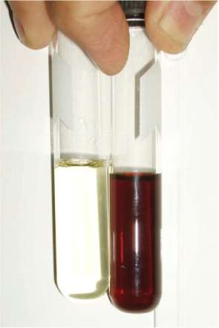

Slide 43
To demonstrate porphyrins, UV fluorescence is the best technique.
The presence of porphyrin precursor in urine is detected by Ehrlich’s reagent.
When urine is observed under ultraviolet light porphyrins if present, will emit strong red fluorescence.
Spectrophotometry : Is Used to Test for Porphyrins & Their Precursors Coproporphyrins and uroporphyrins.
Use of appropriate gene probes has made possible the prenatal diagnosis of some of the porphyrias.

Slide 44



Thank you

